Slide 1
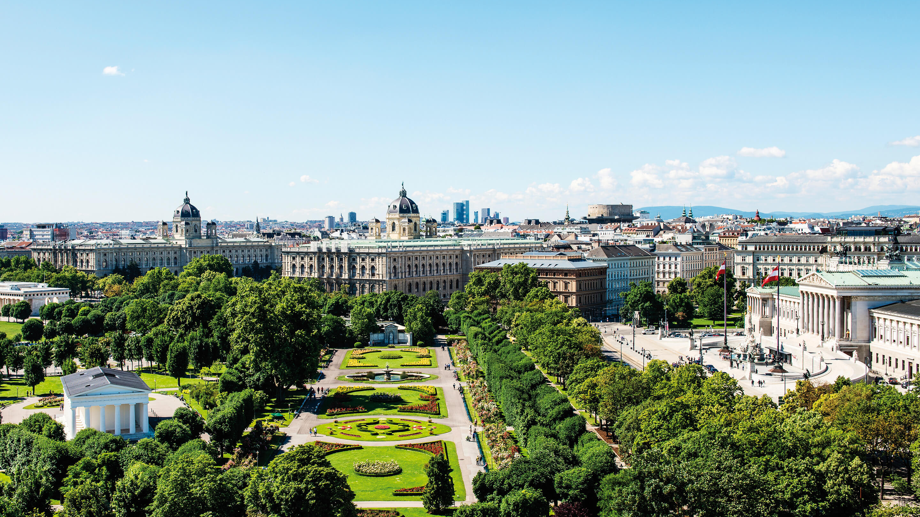


SEMANTICS 2022: Workshops & Tutorials
License Clearance made easy with the Open DALICC Framework
www.dalicc.net
Tassilo Pellegrini, Giray Havur, Sebastian Neumaier
Fachhochschule St. Pölten
SEPTEMBER 2022

Slide 2
TODOs
14:00 – 14:30: Welcome & Introduction of the DALICC initiative (motivation, projects and vision) – Tassilo Pellegrini (Founder & Director of the DALICC Association)
Why licenses are important for digital assets
Capabilities of DALICC: Scenarios in the sense of personas: Amy search/ Leo create /... licenses
Story of DALICC
14:30 – 15:00: DALICC: Background, architecture and service stack – Giray Havur (Lead Developer)
Services (high-level)
Architecture
How we represent licenses: Deontic logic: permissions, prohibitions, duties: 1 example MIT license 1 statement -> RDF statement – link to documentation & vocabulary
Introduction of the license clearance as a reasoning task – talk about dependency graph
15:00 – 15:30 – Big pause
15:30 – 16:15: DALICC: Get your hands dirty … – Giray Havur (Lead Developer) (Google collab)
Part I: How to use DALICC.net
- License library, composer(?), search, faceted search ...
Part II: Use case for DALICC: License clearance for a software project via Python API
- 2.1 How to use the python API (will talk to DALICC REST API)
- 2.2 Coding for license clearance for the git repository – my license (consistent over the dependency graph) checked against these licenses
16:15 – 16:30: DALICC technology roadmap and community activities – Tassilo Pellegrini (Founder & Director of the DALICC Association)
- Where DALICC stands: Future community endeavors/growth directions
16:30 – 17:00: Feedback

Slide 3
Welcome & Introduction of the DALICC initiative
www.dalicc.net
SEPTEMBER 2022

Slide 4
Welcome & Tutorial Structure
14:00 – 14:30: Welcome & Introduction of the DALICC initiative (motivation, projects and vision) – Tassilo Pellegrini (Founder & Director of the DALICC Association)
14:30 – 15:00: DALICC: Background and Framework – Giray Havur (Lead Developer)
15:00 – 15:30: Break
15:30 – 16:15: DALICC: Get your hands dirty … – Giray Havur (Lead Developer)
16:15 – 16:30: DALICC technology roadmap and community activities – Tassilo Pellegrini (Founder & Director of the DALICC Association)
16:30 – 17:00: Discussion & Feedback round

Slide 5





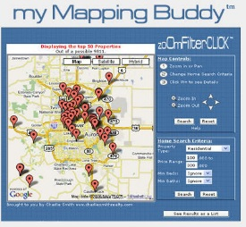







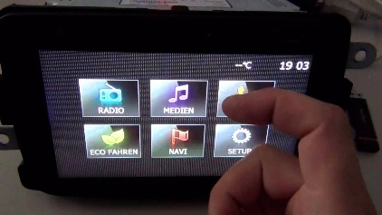



Problems with Licensing
Data
Providers
… negotiate …
Terms of Trade
Terms of Use
Privacy Policy
Misc.
Data
User
Data Set A
License A
Data Set B
License B
Data Set …
License …
License ?
Derivative Work
Data Set N
License N
LICENSE SPECTRUM
Public Domain
Permissive
Weakly Protective
Strongly Protective
Proprietary
No rights reserved
-------------------------- Some rights reserved ------------------------------
All rights reserved

Slide 6









Daily routine of a developer …
Is it allowed?!
Is it feasable?
§
§
§
§
§
§
§
§
In the event of a lack of rights clearance ...
Warning notice
Restraining order
Cease and desist
Claims for damages
Lawyers' fees & court costs

Slide 7

DALICC Personas
What is the best license for my work?
How do licenses differ?
Can I change the license of this work?
How can I keep track of my license portfolio?
How can my employees learn about licensing?
How can I reduce my license clearance costs?
How can I create my personal license?
Can I use these components in combination?

Slide 8

Who is DALICC for?
SW-Developers & Data Engineers
Product Managers & Sales Personnel
Inhouse Lawyers
Law Firms
Libraries & Research Orgs
Compliance-Solution Providers
Data & Software Sharing Platforms
-
Creative producers
8

Slide 9
History & Achievements
Funding History:
2017 to 2020 – Austrian Federal Research Agency
2021 – Austrian Development Bank
2022 – netidee Data Understanding Award
Achievements and Awards:
2017 – Winner of IMAGINE ICT Idea Contest
2019 – Lower Austrian Innovation Award
2021 – AWS Prototype Grant
2022 – Data Understanding Award
Community & Partnerships:
DBpedia
DANS - Dutch national centre of expertise and repository for research data
ODISSEI - Open Data Infrastructure for Social Science and Economic Innovations
Time Machine Project - Invigorating European History With The Big Data Of The Past
FAIR Commons Austria
Electronic Frontier Foundation (EFF Europe)
… and more to come …

Slide 10
DALICC: Background and Framework
Data Model
Reasoning Tasks
Technology Stack
Framework
www.dalicc.net
SEPTEMBER 2022

Slide 11

Data Model
License Representation
My license
Vocabulary
+
Permissions
ODRL odrl: http://www.w3.org/ns/odrl/2/
CCRel cc: http://creativecommons.org/ns#
-
Prohibitions
My license
Dublin Core dcmitype: http://purl.org/dc/dcmitype/ dct: http://purl.org/dc/terms/
Schema.org scho: http://schema.org/
!
Duties
Other data
(e.g., provenance)
δ
opensource.org osl: http://opensource.org/licenses/ FOAF foaf: http://xmlns.com/foaf/0.1/
*
α
β
κ
λ
DALICC dalicc: http://dalicc.net/ns# dalicclib: http://dalicc.net/licenselibrary/
δ
μ
π
ω

Slide 12
Data Model
License Representation
My license
+
Permissions
dalicclib:myLicense a odrl:Set ;
dct:title “My License” ;
cc:jurisdiction dalicc:worldwide ;
cc:license dalicclib:CC-BY_v4 ;
dalicc:validityType dalicc:perpetual ;
odrl:duty [ a odrl:Duty;
odrl:action δ ],
odrl:permission [ a odrl:Permission ;
odrl:action α ],
odrl:permission [ a odrl:Permission ;
odrl:action β ;
odrl:duty [ a odrl:Duty ;
odrl:action κ ],
odrl:duty [ a odrl:Duty ;
odrl:action λ ] ],
odrl:permission [ a odrl:Permission ;
odrl:action δ ;
odrl:duty [ a odrl:Duty ;
odrl:action μ ] ];
odrl:prohibition [ a odrl:Prohibition ;
odrl:action π ],
[ a odrl:Prohibition ;
odrl action ω ] .
-
Prohibitions
My license
!
Duties
*
Other data
(e.g., provenance)
δ
α
β
κ
λ
δ
μ
π
ω

Slide 13
Data Model
License Representation
My license
+
Permissions
dalicclib:myLicense a odrl:Set ;
dct:title “My License” ;
cc:jurisdiction dalicc:worldwide ;
cc:license dalicclib:CC-BY_v4 ;
dalicc:validityType dalicc:perpetual ;
odrl:duty [ a odrl:Duty;
odrl:action δ ],
odrl:permission [ a odrl:Permission ;
odrl:action α ],
odrl:permission [ a odrl:Permission ;
odrl:action β ;
odrl:duty [ a odrl:Duty ;
odrl:action κ ],
odrl:duty [ a odrl:Duty ;
odrl:action λ ] ],
odrl:permission [ a odrl:Permission ;
odrl:action δ ;
odrl:duty [ a odrl:Duty ;
odrl:action μ ] ];
odrl:prohibition [ a odrl:Prohibition ;
odrl:action π ],
[ a odrl:Prohibition ;
odrl action ω ] .
-
Prohibitions
My license
!
Duties
*
Other data
(e.g., provenance)
δ
α
β
κ
λ
δ
μ
π
ω

Slide 14
Data Model
License Representation
My license
+
Permissions
dalicclib:myLicense a odrl:Set ;
dct:title “My License” ;
cc:jurisdiction dalicc:worldwide ;
cc:license dalicclib:CC-BY_v4 ;
dalicc:validityType dalicc:perpetual ;
odrl:duty [ a odrl:Duty;
odrl:action δ ],
odrl:permission [ a odrl:Permission ;
odrl:action α ],
odrl:permission [ a odrl:Permission ;
odrl:action β ;
odrl:duty [ a odrl:Duty ;
odrl:action κ ],
odrl:duty [ a odrl:Duty ;
odrl:action λ ] ],
odrl:permission [ a odrl:Permission ;
odrl:action δ ;
odrl:duty [ a odrl:Duty ;
odrl:action μ ] ];
odrl:prohibition [ a odrl:Prohibition ;
odrl:action π ],
[ a odrl:Prohibition ;
odrl action ω ] .
-
Prohibitions
My license
!
Duties
*
Other data
(e.g., provenance)
δ
α
β
κ
!
DALICC Vocabulary Documentation @
https://docs.dalicc.net/
λ
δ
μ
π
ω

Slide 15

Reasoning Tasks
Overview
Consistency
Check Program
CONSISTENCY
CHECK
Yes / No
(with explanations)
Reasoner
COMPATIBILITY
CHECK
Yes / No
(with explanations)
Reasoner
Compatibility
Check Program

Slide 16
Reasoning Tasks
Consistency Check
My license v2
δ
α
β
κ
λ
δ
μ
α
ω

Slide 17
Reasoning Tasks
Consistency Check
My license v2
δ
α
β
κ
λ
δ
μ
α
ω

Slide 18
Reasoning Tasks
Consistency Check
My license v3
δ
α
β
κ
λ
δ
μ
π
ω

Slide 19
Reasoning Tasks
Consistency Check
My license v3
WHAT IF?
π is a subset of action α
β and π means the same action defined in different vocabularies
α and δ are known to be conflicting actions
…
δ
α
β
κ
λ
δ
μ
π
ω

Slide 20
Data Model
Dependency Graph
Encoding the explicit and implicit semantic relationships between defined actions
1. hierarchical relationships between action
- α odrl:includedIn β : all Rules defined for β must also hold for α, but not necessarily vice versa.
- e.g., odrl:display odrl:includedIn odrl:present.
2. implications derived from a specific action
- α odrl:implies β : a Prohibition of β conflicts a Permission of α, but not necessarily vice versa.
- e.g., cc:Attribution odrl:implies cc:Notice.
3. equalities
- α owl:sameAs β : all Rules defined for β must also hold for α, and vice versa.
- e.g., odrl:copy owl:sameAs odrl:reproduce.
4. contradictions between specific actions
- α dalicc:contradicts β : a Permission of β conflicts a Permission of α, and vice versa.
- e.g., cc:ShareAlike dalicc:contradicts dalicc:addStatement.

Slide 21

Reasoning Tasks
Overview
Consistency
Check Program
CONSISTENCY
CHECK
Yes / No
(with explanations)
Reasoner
DEPENDENCY
GRAPH
COMPATIBILITY
CHECK
Yes / No
(with explanations)
Reasoner
Compatibility
Check Program

Slide 22
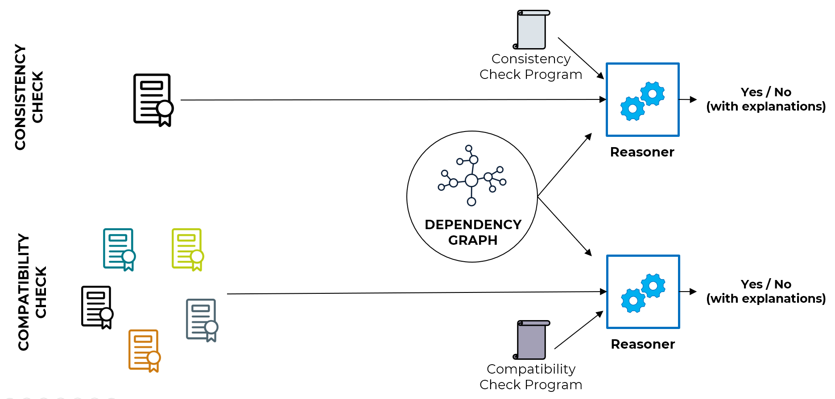
Data Model
Dependency Graph
Describes specific interpretation of relations between actions in deontic reasoning
- E.g., Juristictions might differ in interpreting actions
DEPENDENCY
GRAPH

Slide 23
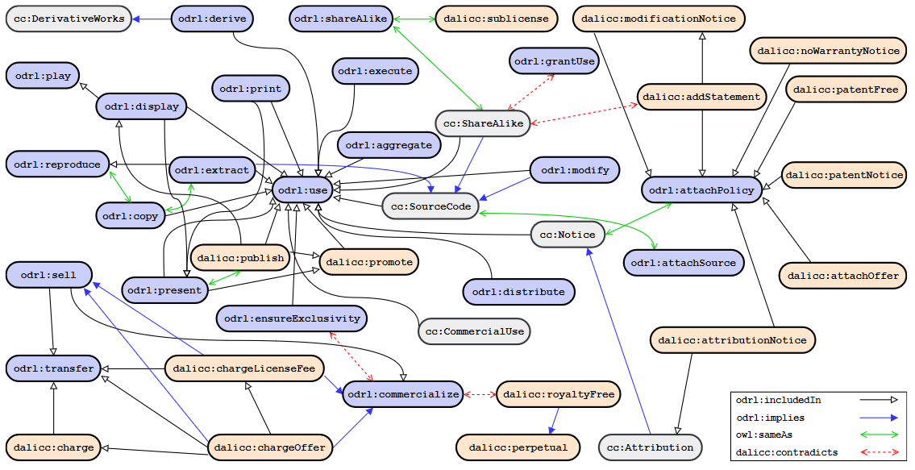
Data Model
An Example of Dependency Graph

Slide 24
Reasoning Tasks
Compatibility Check
License-1
License-2
License-3
DERIVED CONFLICTS
δ
β
ω
α
κ
π
π
λ
δ
α
κ
δ
μ

Slide 25

Reasoning Tasks
Compatibility Check
License-1
License-2
License-3
License-2
DERIVED CONFLICTS
L1, α permitted x L2, α prohibited
L1, δ obliged x L2, δ prohibited
L3, π permitted x L1, π prohibited
δ
β
ω
α
κ
π
π
λ
δ
α
κ
δ
μ

Slide 26
Reasoning Tasks
Compatibility Check
License-1
License-2
License-3
License-2
DERIVED CONFLICTS
L1, α permitted x L2, α prohibited
L1, δ obliged x L2, δ prohibited
L3, π permitted x L1, π prohibited
δ
β
ω
α
κ
π
π
λ
δ
α
κ
δ
μ
κ owl:sameAs β
DEPENDENCY
GRAPH

Slide 27
Reasoning Tasks
Compatibility Check
License-1
License-2
License-3
License-2
DERIVED CONFLICTS
L1, α permitted x L2, α prohibited
L1, δ obliged x L2, δ prohibited
L3, π permitted x L1, π prohibited
L2, β permitted x L3, κ prohibited
δ
β
ω
α
κ
π
π
λ
δ
α
κ
δ
μ
κ owl:sameAs β
DEPENDENCY
GRAPH

Slide 28
Reasoning Tasks
Compatibility Check
License-1
License-2
License-3
License-2
DERIVED CONFLICTS
L1, α permitted x L2, α prohibited
L1, δ obliged x L2, δ prohibited
L3, π permitted x L1, π prohibited
L2, β permitted x L3, κ prohibited
δ
β
ω
α
κ
π
π
λ
δ
α
κ
δ
μ
hierarchical relationships between action
- α odrl:includedIn β : all Rules defined for β must also hold for α, but not necessarily vice versa.
- e.g., odrl:display odrl:includedIn odrl:present.
κ owl:sameAs β
ω odrl:includedIn α
DEPENDENCY
GRAPH

Slide 29
Reasoning Tasks
Compatibility Check
License-1
License-2
License-3
License-2
DERIVED CONFLICTS
L1, α permitted x L2, α prohibited
L1, δ obliged x L2, δ prohibited
L3, π permitted x L1, π prohibited
L2, β permitted x L3, κ prohibited
L3, ω permitted x L2, α prohibited
δ
β
ω
α
κ
π
π
λ
δ
α
κ
δ
μ
κ owl:sameAs β
ω odrl:includedIn α
DEPENDENCY
GRAPH
Notes:
1. hierarchical relationships between action
- α odrl:includedIn β : all Rules defined for β must also hold for α, but not necessarily vice versa.
- e.g., odrl:display odrl:includedIn odrl:present.
2. implications derived from a specific action
- α odrl:implies β : a Prohibition of β conflicts a Permission of α, but not necessarily vice versa.

Slide 30
Reasoning Tasks
Compatibility Check
License-1
License-2
License-3
License-2
DERIVED CONFLICTS
L1, α permitted x L2, α prohibited
L1, δ obliged x L2, δ prohibited
L3, π permitted x L1, π prohibited
L2, β permitted x L3, κ prohibited
δ
β
ω
α
κ
π
π
λ
δ
α
κ
δ
μ
hierarchical relationships between action
- α odrl:includedIn β : all Rules defined for β must also hold for α, but not necessarily vice versa.
- e.g., odrl:display odrl:includedIn odrl:present.
κ owl:sameAs β
α odrl:includedIn ω
DEPENDENCY
GRAPH
Notes:
1. hierarchical relationships between action
- α odrl:includedIn β : all Rules defined for β must also hold for α, but not necessarily vice versa.
- e.g., odrl:display odrl:includedIn odrl:present.
2. implications derived from a specific action
- α odrl:implies β : a Prohibition of β conflicts a Permission of α, but not necessarily vice versa.

Slide 31
Reasoning Tasks
Compatibility Check
License-1
License-2
License-3
License-2
DERIVED CONFLICTS
L1, α permitted x L2, α prohibited
L1, δ obliged x L2, δ prohibited
L3, π permitted x L1, π prohibited
L2, β permitted x L3, κ prohibited
δ
β
ω
α
κ
π
π
λ
δ
α
κ
δ
μ
κ owl:sameAs β
α odrl:includedIn ω
DEPENDENCY
GRAPH
Notes:
1. hierarchical relationships between action
- α odrl:includedIn β : all Rules defined for β must also hold for α, but not necessarily vice versa.
- e.g., odrl:display odrl:includedIn odrl:present.
2. implications derived from a specific action
- α odrl:implies β : a Prohibition of β conflicts a Permission of α, but not necessarily vice versa.

Slide 32
Reasoning Tasks
Compatibility Check
License-1
License-2
License-3
License-2
DERIVED CONFLICTS
L1, α permitted x L2, α prohibited
L1, δ obliged x L2, δ prohibited
L3, π permitted x L1, π prohibited
L2, β permitted x L3, κ prohibited
δ
β
ω
α
κ
π
π
λ
δ
α
κ
δ
μ
implications derived from a specific action
- α odrl:implies β : a Prohibition of β conflicts a Permission of α, but not necessarily vice versa.
- i.e., a Prohibition of α is not in conflict with a Permission of β
- e.g., cc:Attribution odrl:implies cc:Notice.
κ owl:sameAs β
ω odrl:implies α
DEPENDENCY
GRAPH
Notes:
1. hierarchical relationships between action
- α odrl:includedIn β : all Rules defined for β must also hold for α, but not necessarily vice versa.
- e.g., odrl:display odrl:includedIn odrl:present.
2. implications derived from a specific action
- α odrl:implies β : a Prohibition of β conflicts a Permission of α, but not necessarily vice versa.

Slide 33

Reasoning Tasks
Compatibility Check
License-1
License-2
License-3
License-2
DERIVED CONFLICTS
L1, α permitted x L2, α prohibited
L1, δ obliged x L2, δ prohibited
L3, π permitted x L1, π prohibited
L2, β permitted x L3, κ prohibited
L3, ω permitted x L2, α prohibited
δ
β
ω
α
κ
π
π
λ
δ
α
κ
δ
μ
κ owl:sameAs β
ω odrl:implies α
DEPENDENCY
GRAPH
Notes:
1. hierarchical relationships between action
- α odrl:includedIn β : all Rules defined for β must also hold for α, but not necessarily vice versa.
- e.g., odrl:display odrl:includedIn odrl:present.
2. implications derived from a specific action
- α odrl:implies β : a Prohibition of β conflicts a Permission of α, but not necessarily vice versa. (i.e., a Prohibition of α is not in conflict with a Permission of β)

Slide 34











Technology Stack
REPOSITORY
FRONTEND
BACKEND
HEXLITE
DATA
INFRA

Slide 35
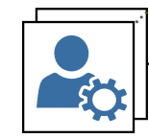
Framework
DALICC SERVICES
API SERVICES
REASONER
LICENSE SEARCH
WEB SERVICE
HEXLITE
LICENSE COMPOSER
DALICC USERS
api.dalicc.net
LICENSE
LIBRARY
DEPENDENCY
GRAPH
USER
DATA
dalicc.net
UI: LICENSE SEARCH / COMPOSE / CLEARANCE / CONFLICT DETECTION

Slide 36
DALICC: Hands-on session
API Services
Service UIs at dalicc.net
Creating a License
Consistency Check
Compatibility Check among Licenses
www.dalicc.net
SEPTEMBER 2022

Slide 37
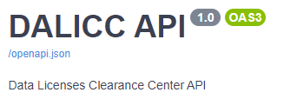
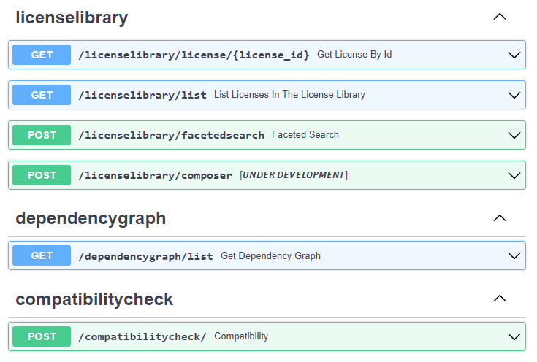
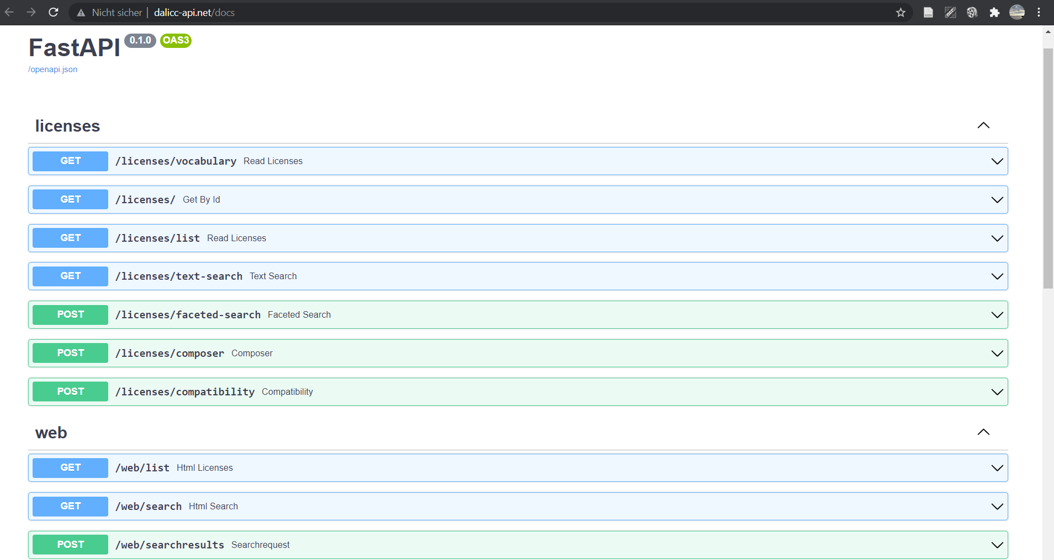
API Services
https://api.dalicc.net/docs

Slide 38
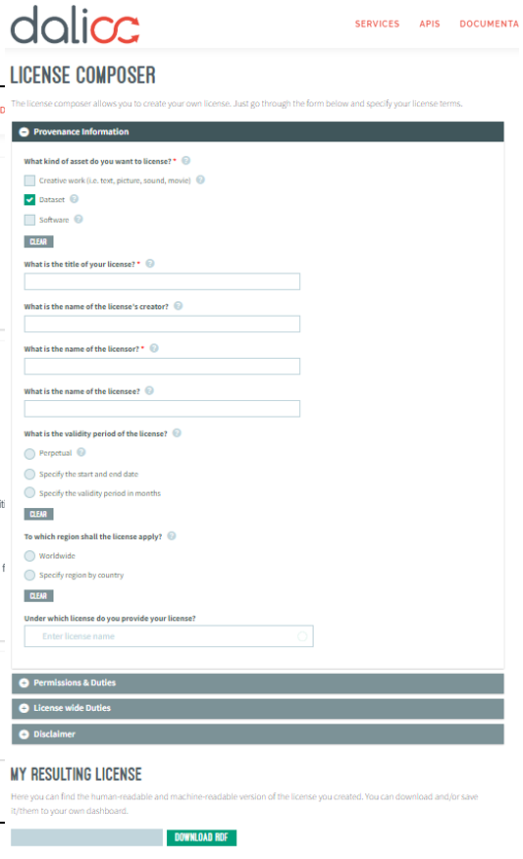
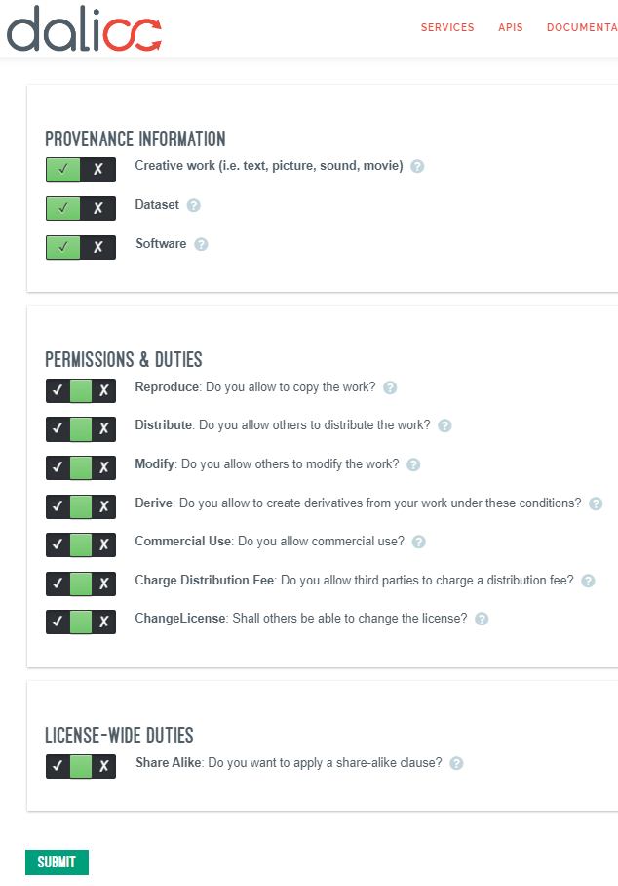
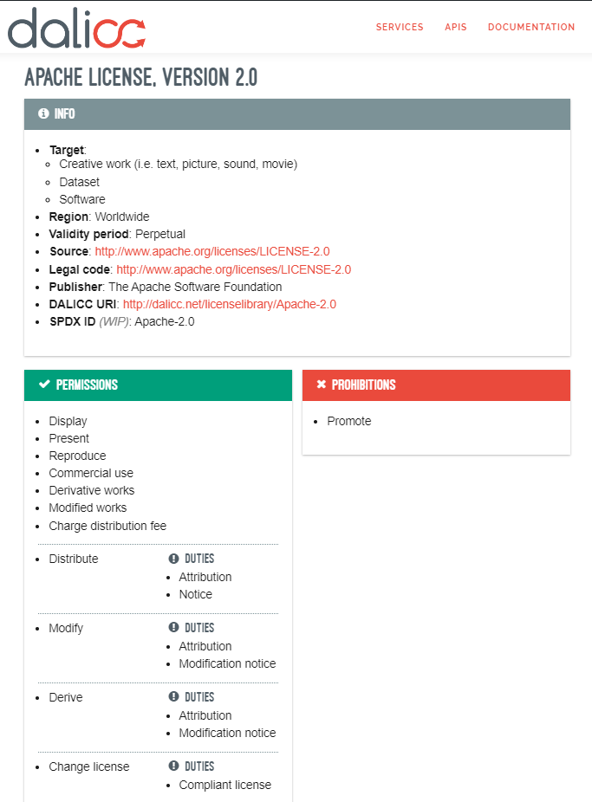
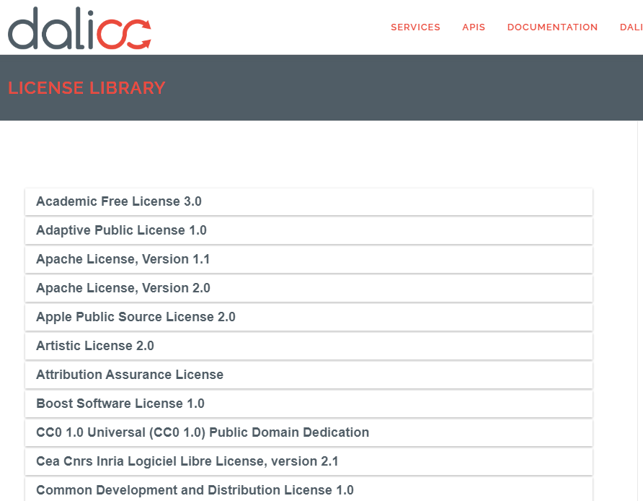
Service UIs at dalicc.net
Under
construction

Slide 39
Creating a License

Slide 40
Consistency Check

Slide 41
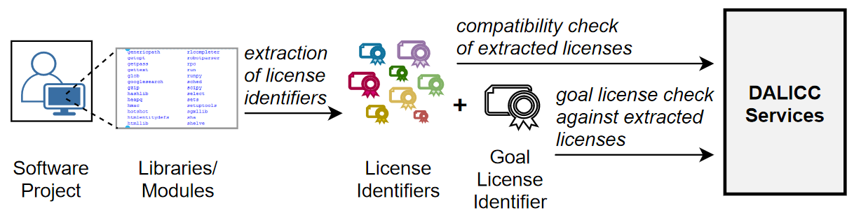
Compatibility Check Use-Case
E.g.,

Slide 42
DALICC: The road ahead …
www.dalicc.net
SEPTEMBER 2022

Slide 43






Roadmap
Autumn 2022
Winter 2022
Spring 2023
Summer 2023
FUNCTIONAL | License composer interface Automated verification of user-created licenses Multi-format export of licenses in the license library (JSON-LD … ) | Versioning and editing history of licenses Versioning and editing history of user-specific dependency graphs | Open-source / community: Tools and interfaces for reviewing user-created licenses by active members Decentralized integrity check against tampering (e.g., via a blockchain) | Support for automated discovery of machine-readable identifiers of open-source/community licenses for big scale digital asset platforms and SDK/IDEs Support for automated extraction of licenses from big scale digital asset platforms for license clearance/relicensing purposes
USER FEATURES |  | User dashboard: User management, access control for user-created licenses, unique persistent identifiers (e.g., URN) for user-created licenses | Audit of user-created licenses by legal experts

Slide 44
Thank you for your attention!
Contact: tassilo.pellegrini@fhstp.ac.at
giray.havur@fhstp.ac.at
Website: www.dalicc.net
Acknowledgments:
Between November 2016 - October 2018 DALICC was funded by the Austrian Federal Ministry of Transport, Innovation and Technology (BMVIT) under the program "ICT of the Future".
In 2021 DALICC is funded by the Austria Wirtschaftsservice Gesellschaft mbH (aws), the promotional bank of the Austrian federal government.
Since 01.01.2022 DALICC is funded by netidee Internet Stiftung.

Slide 45
Discussion & Feedback
Autumn 2022
Winter 2022
Spring 2023
Summer 2023
FUNCTIONAL | License composer interface Automated verification of user-created licenses Multi-format export of licenses in the license library (JSON-LD … ) | Versioning and editing history of licenses Versioning and editing history of user-specific dependency graphs | Open-source / community: Tools and interfaces for reviewing user-created licenses by active members Decentralized integrity check against tampering (e.g., via a blockchain) | Support for automated discovery of machine-readable identifiers of open-source/community licenses for big scale digital asset platforms and SDK/IDEs Support for automated extraction of licenses from big scale digital asset platforms for license clearance/relicensing purposes
USER FEATURES |  | User dashboard: User management, access control for user-created licenses, unique persistent identifiers (e.g., URN) for user-created licenses | Audit of user-created licenses by legal experts

Slide 46
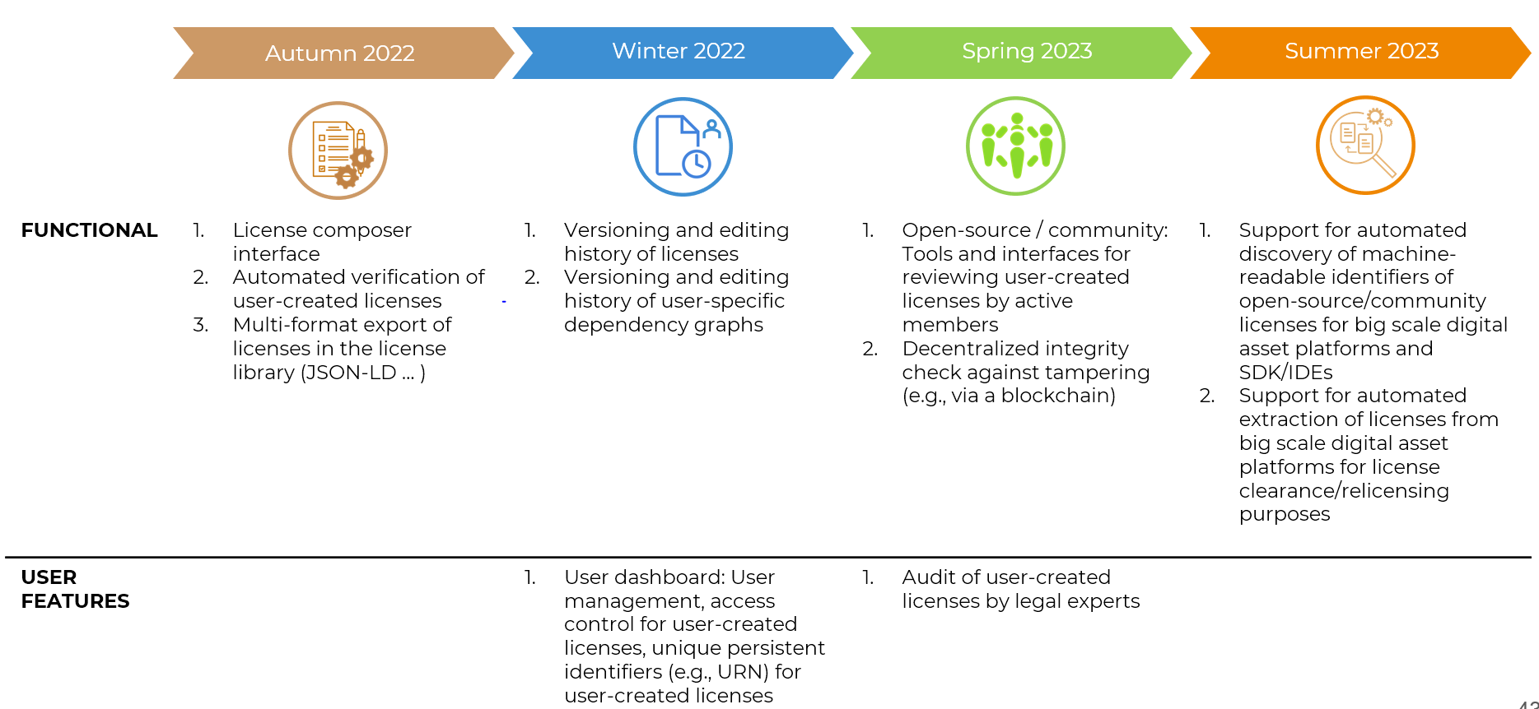
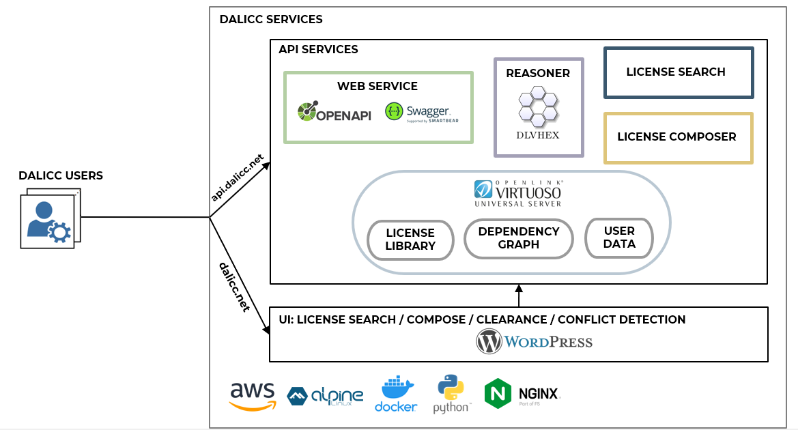
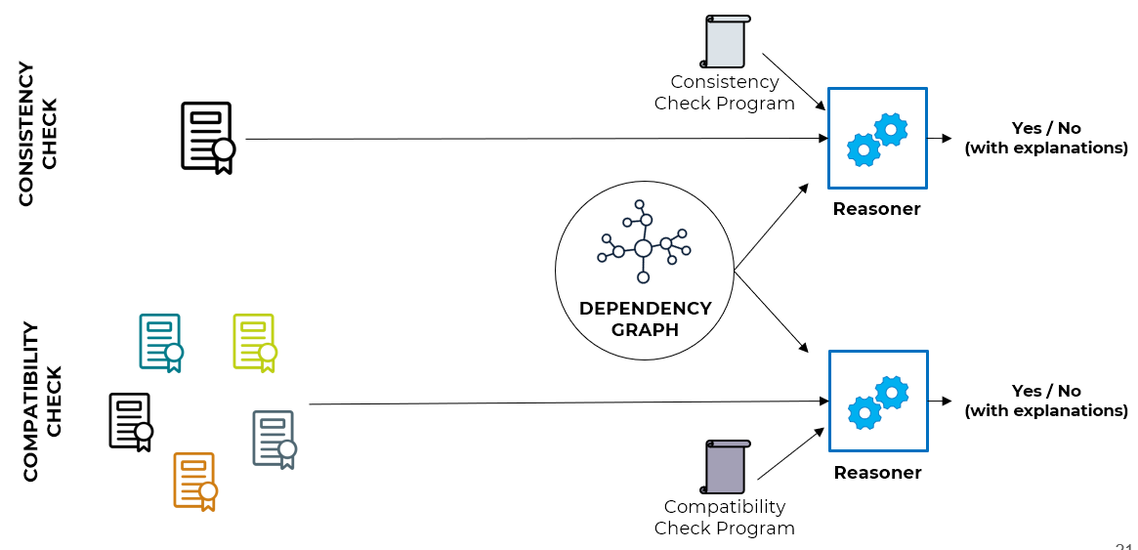

Discussion & Feedback

